Slide 1
BrainBlaze – Quiz Website
a digital platform designed to test users' knowledge of various technical subjects.
Mehak (2131883)
Project Developer

Slide 2
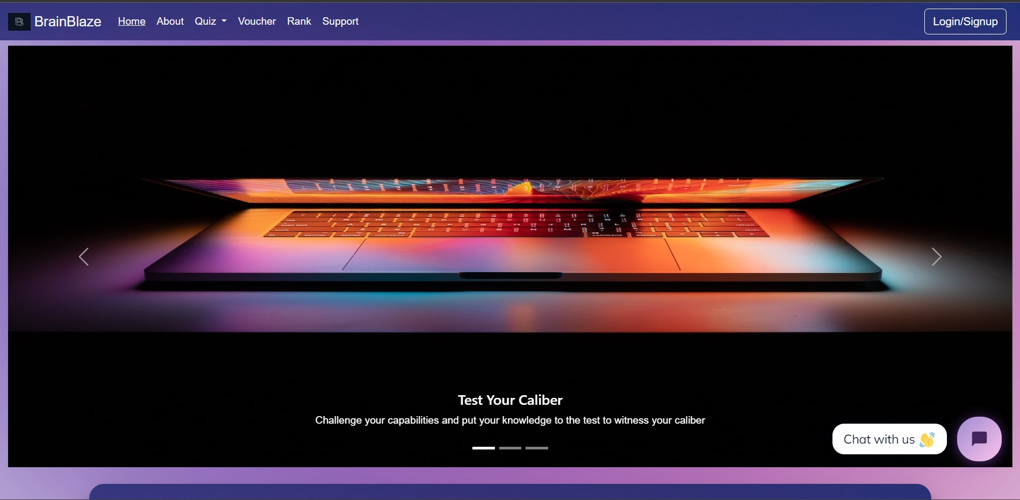
Welcome to BrainBlaze
Welcome to Brain Blaze, the ultimate technical quiz app! Embark on a journey to challenge and expand your technical prowess. Our app offers a diverse array of brain-teasing questions. Ignite your curiosity, compete against peers, and elevate your tech knowledge with Brain Blaze.

Slide 3
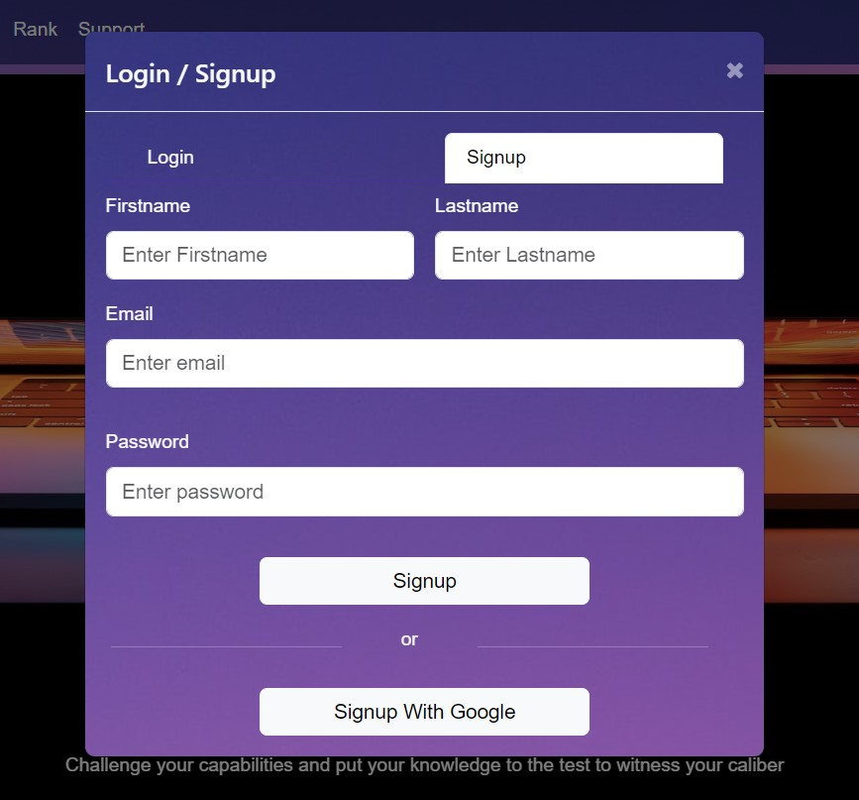
Signup Modal
To join the Brain Blaze community, Create your account and embark on a journey of technical discovery! Fill in your details or signup with Google to access a world of captivating quizzes and expand your knowledge horizons with us."

Slide 4
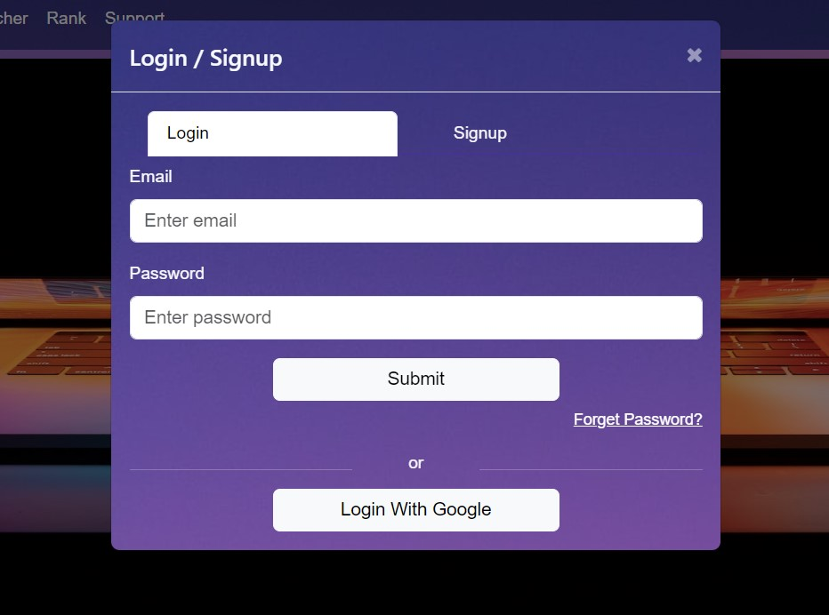
Login Modal
Step into the world of knowledge at Brain Blaze! Please log in to access our captivating technical quizzes.

Slide 5
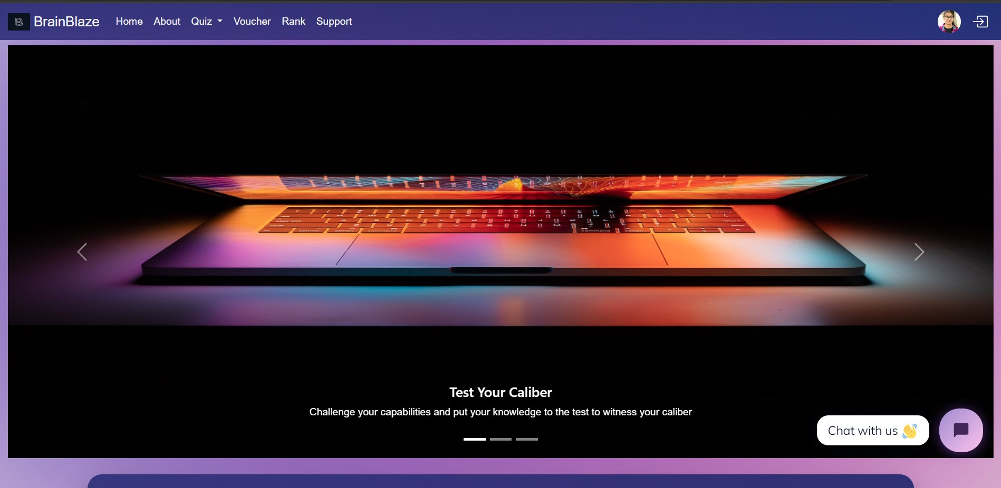
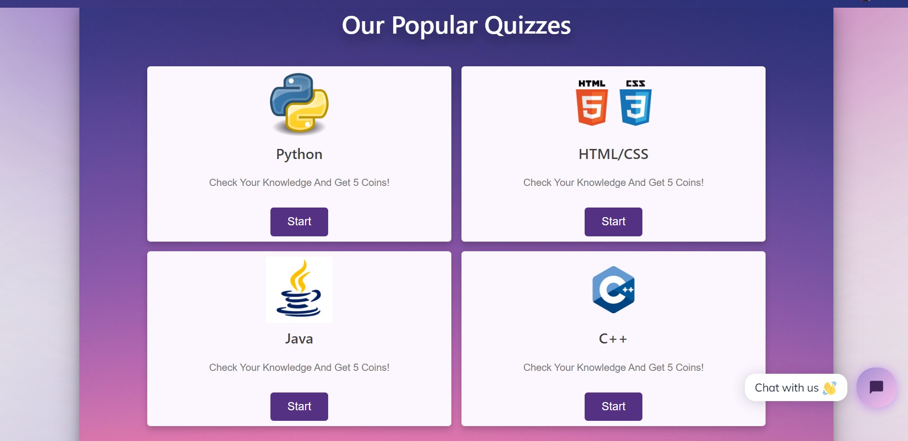
Home Page

Slide 6
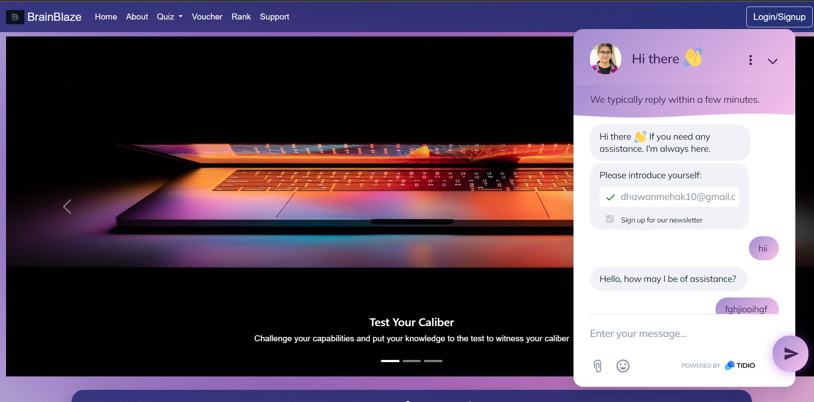
Chatbot
Introducing our interactive chatbot! Engage in insightful conversations and seek assistance. Interact and discover new dimensions of information through intuitive conversations with our chatbot.

Slide 7
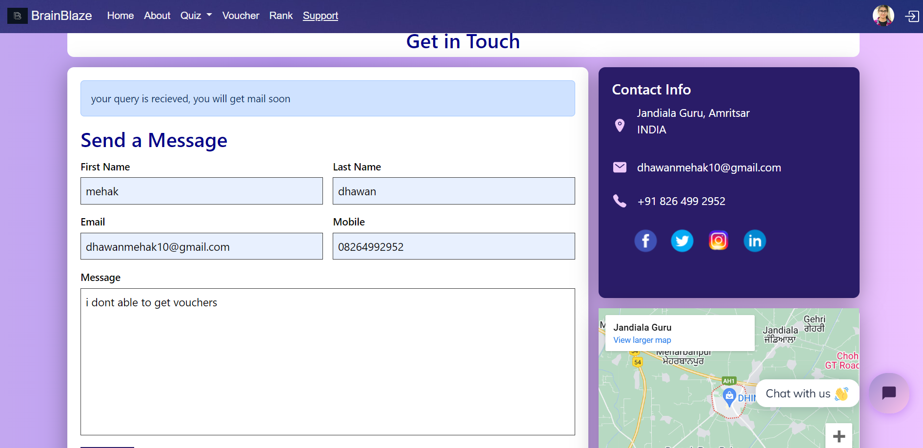
Support
Introducing our interactive chatbot! Engage in insightful conversations and seek assistance. Interact and discover new dimensions of information through intuitive conversations with our chatbot.

Slide 8
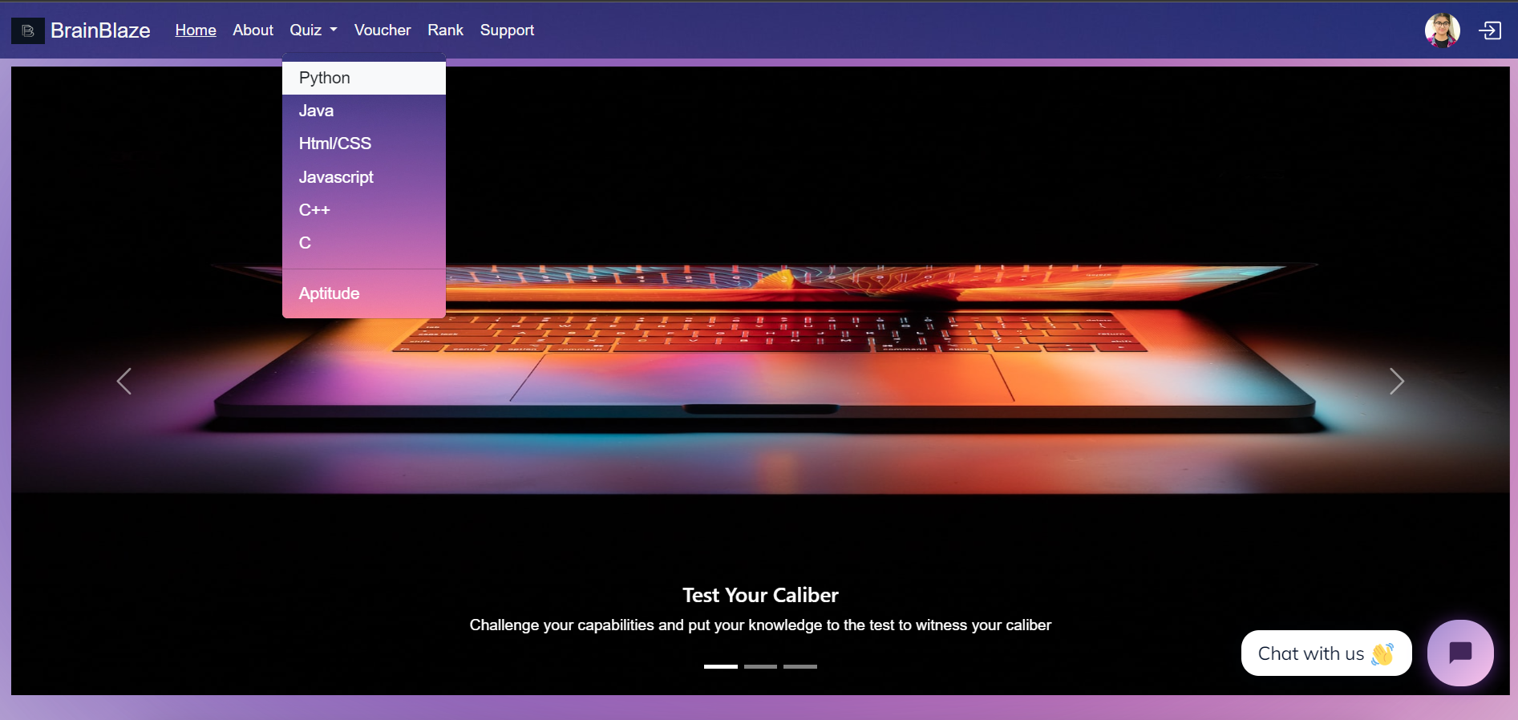
Quiz Dropdown
Explore our diverse quiz selection! Choose from a dropdown menu of captivating technical topics and embark on a challenging learning journey.

Slide 9
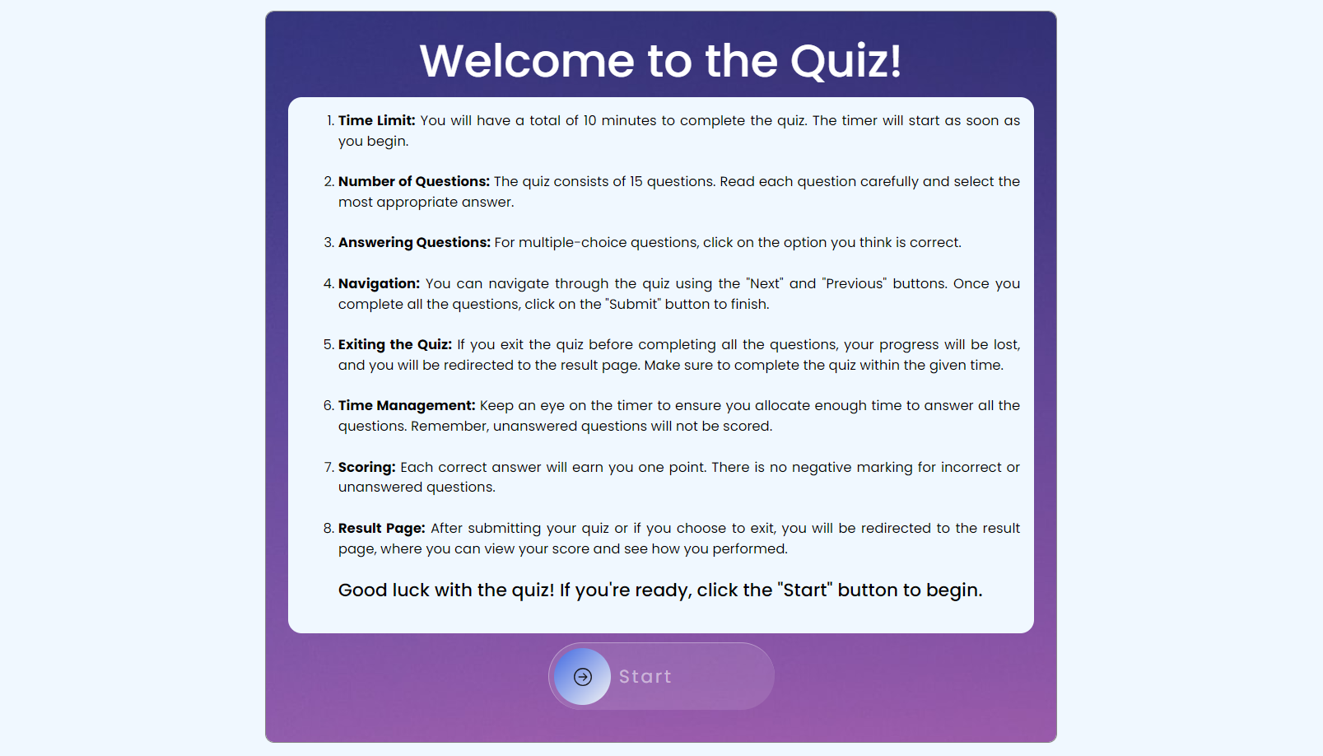
Quiz Instructions
Before diving into the quiz, let's set the stage! Read through the quiz instructions carefully to understand the rules, time limits, and scoring system.

Slide 10
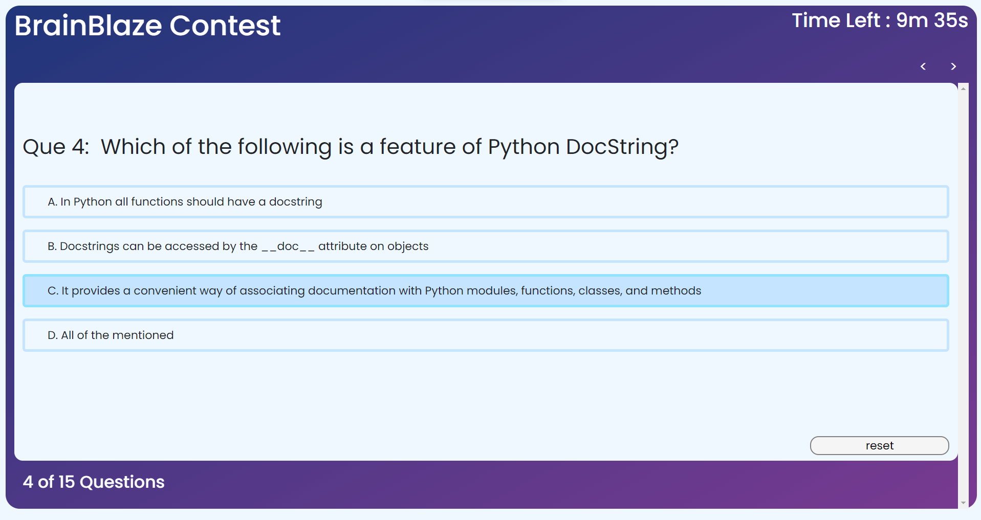
Quiz
Click or tap on one of the provided options to select your answer. Your chosen option will be highlighted, indicating your selection.

Slide 11
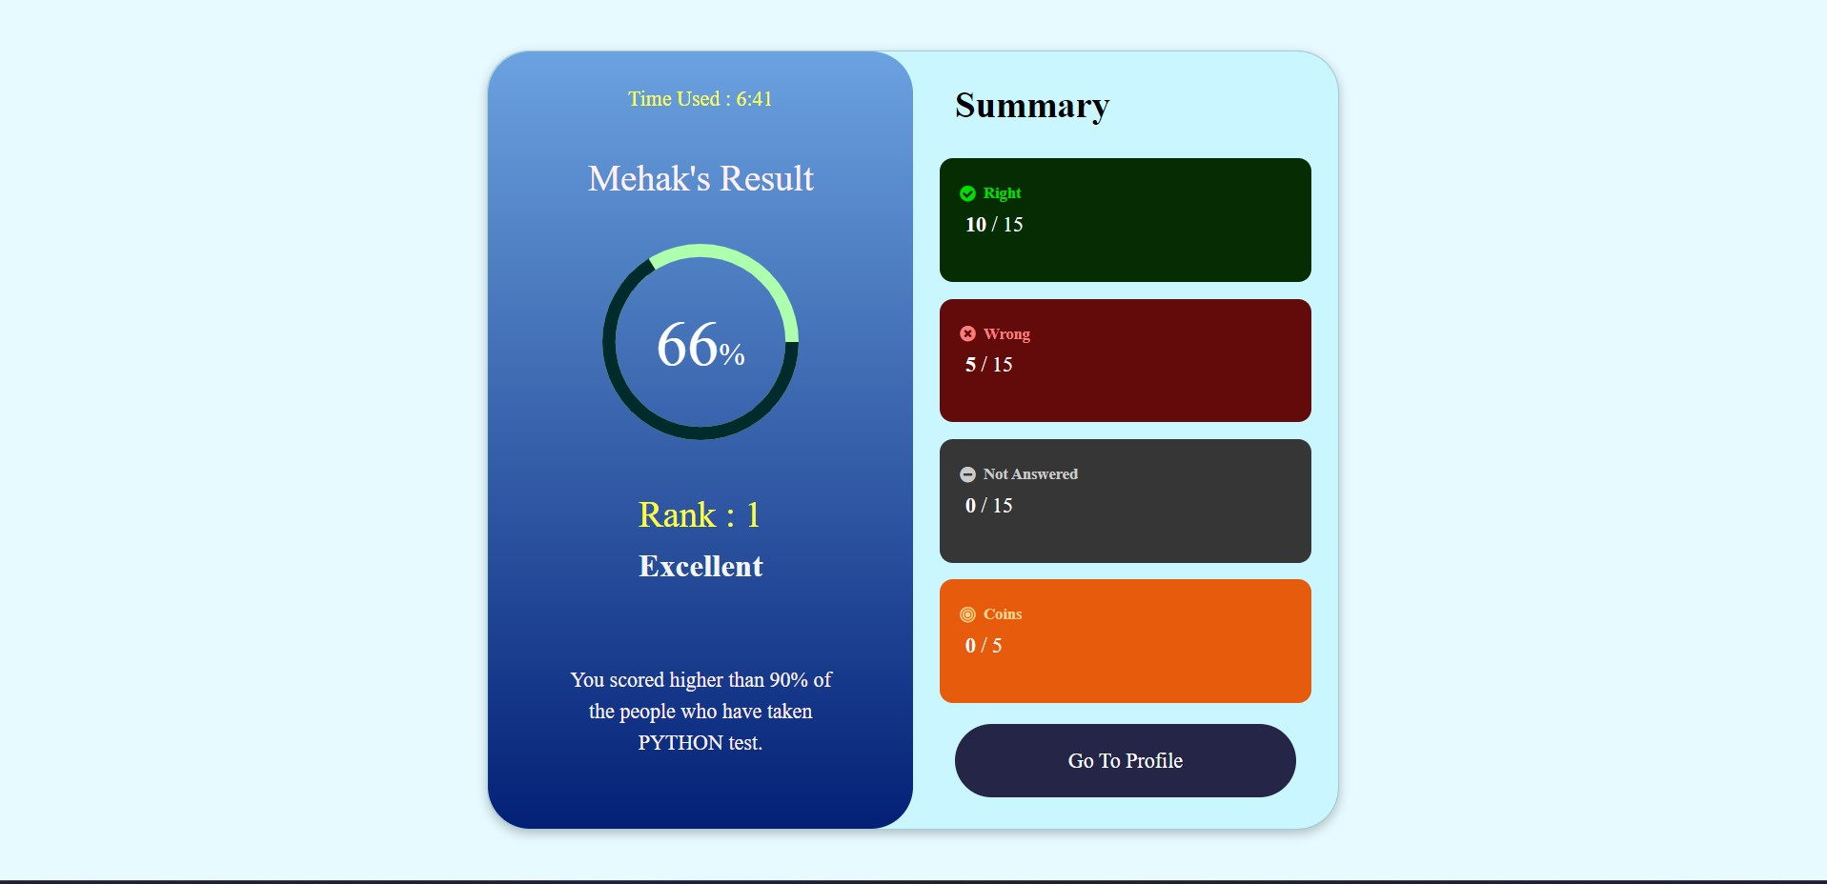
Result
Discover how you performed on the quiz and see how your technical knowledge stacks up. From correct answers to your score, the result page provides insights into your learning journey.

Slide 12
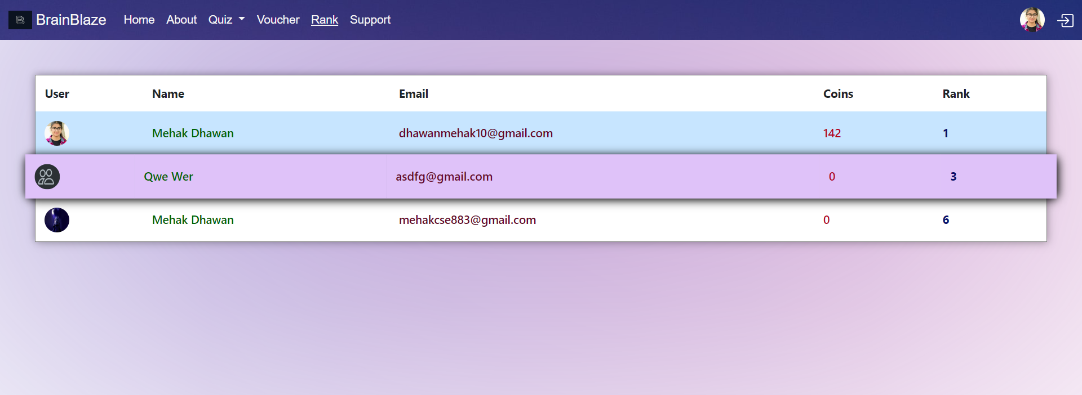
Rank
Reach for the top spot on leaderboard! Compete against fellow learners, earn points by acing quizzes, and climb the ranks to showcase your technical expertise

Slide 13
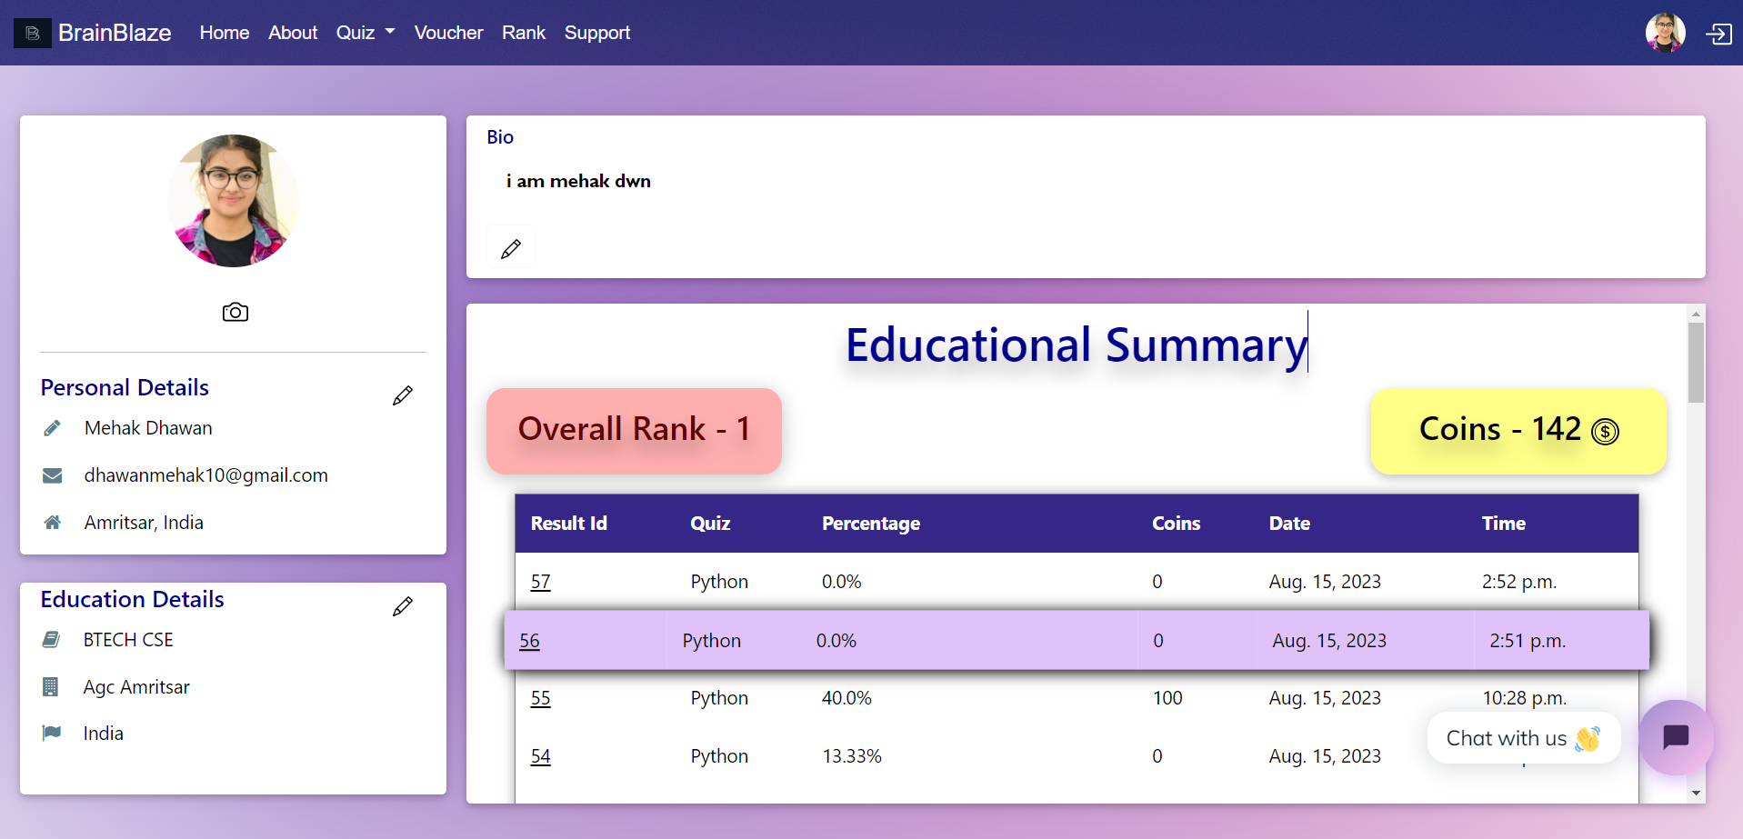
User Profile
Your personalized profile hub awaits! Access your achievements and track quiz progress. Customize your profile to reflect your educational details and showcase your accomplishments.

Slide 14
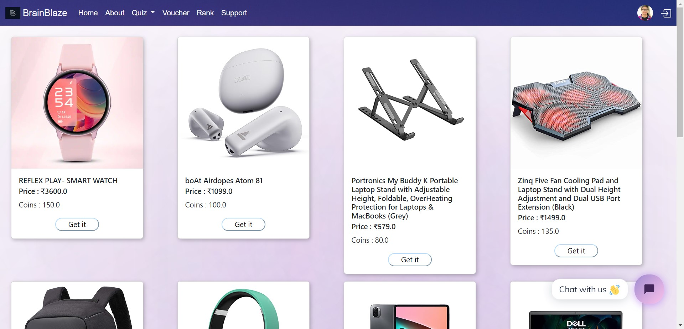
Vouchers
Earn vouchers as you collect coins from completing quizzes! It enhance your experience with BrainBlaze. It's not just about learning; it's about rewarding your journey of knowledge.

Slide 15
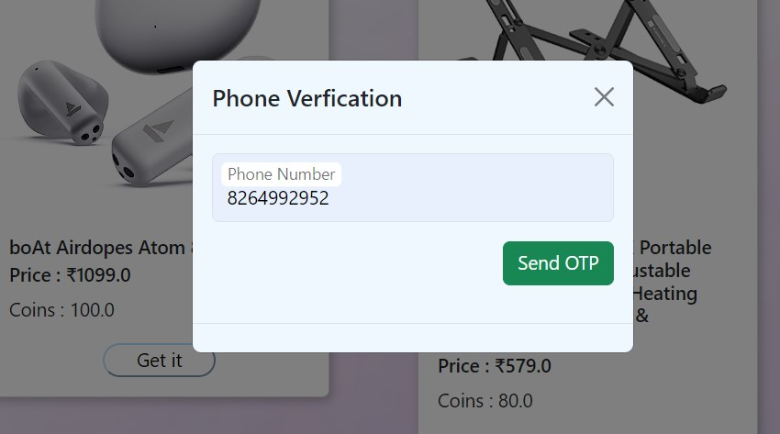
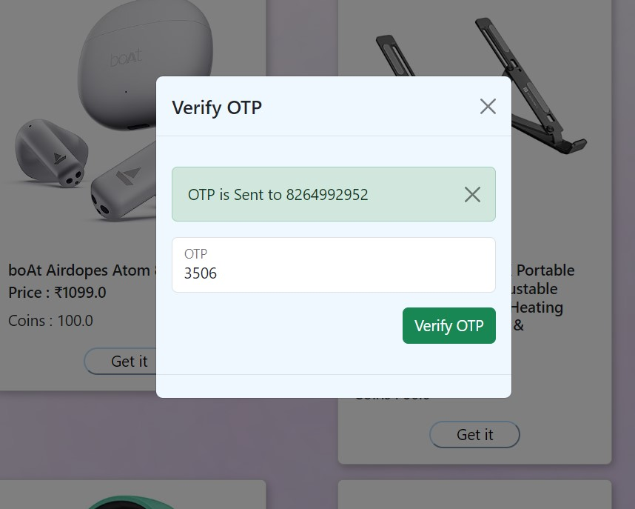
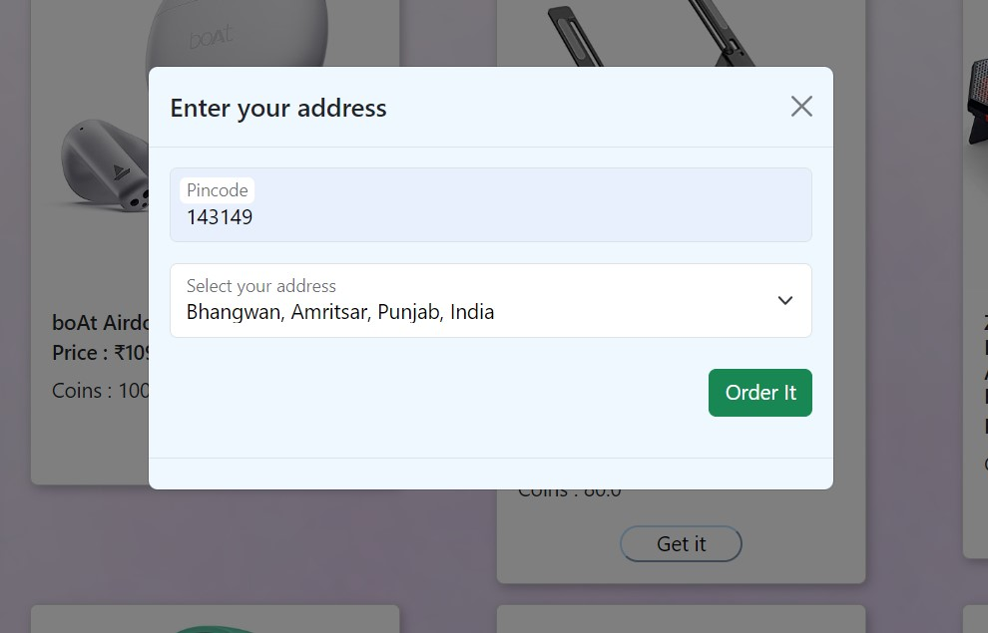
Vouchers
Click on 'Get It' to claim your voucher! Once you've collected enough coins by acing quizzes, simply hit the 'Get It' button to redeem your well-deserved voucher.
Enter Phone No.
Enter OTP
Enter Your Pincode

Slide 16
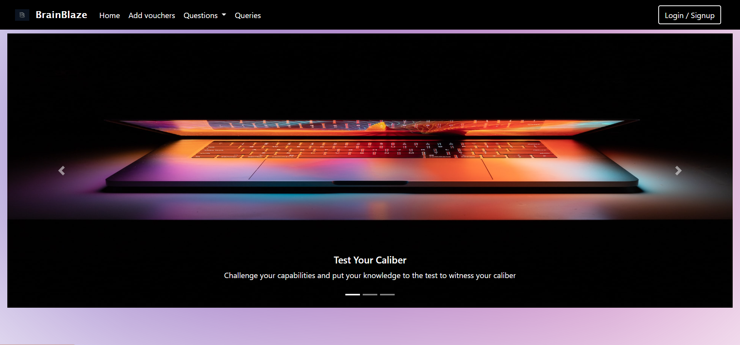
Welcome to BB-Employee
Welcome to the Employee Home Page! This dynamic platform empowers you to manage various aspects of your engagement. Here , you can easily Add Vouchers and apply all crud operations on Question

Slide 17
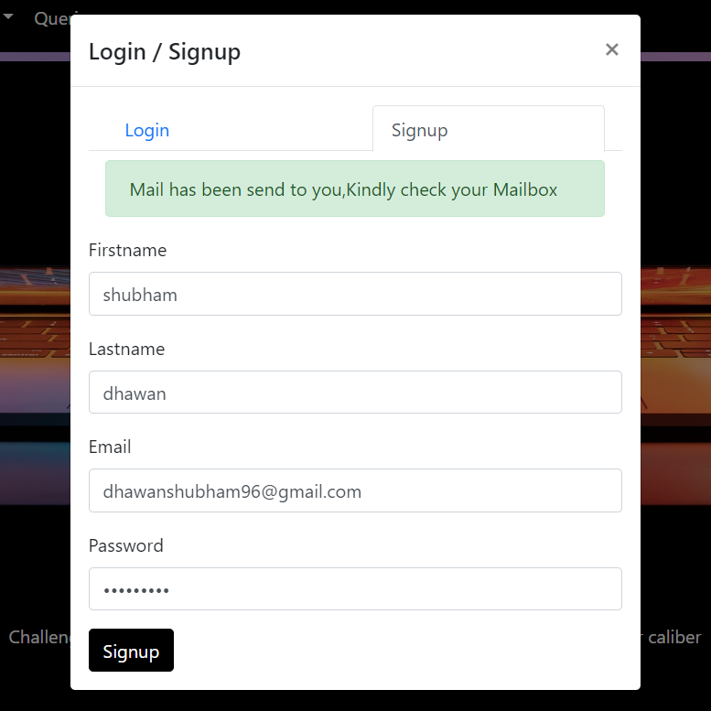
Signup Modal
Join employee community! Sign up to create your account and unlock a suite of valuable tools and resources. Enter your details to get started on your journey.

Slide 18
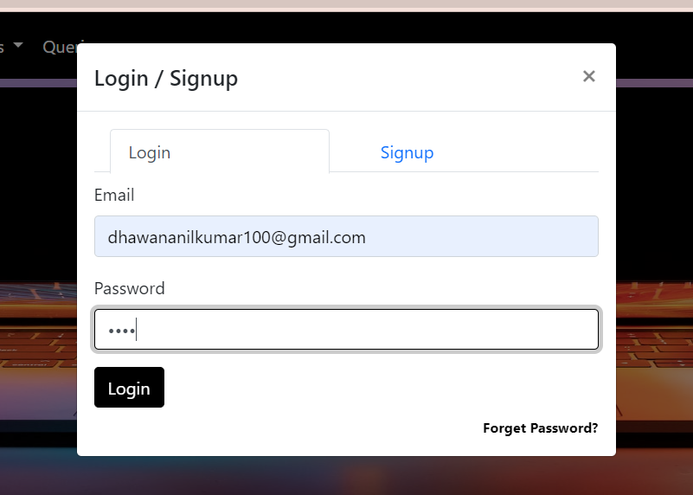
Login Modal
Access your personalized workspace. Enter your credentials to securely log in and explore a world of work-related tools, information, and resources.

Slide 19
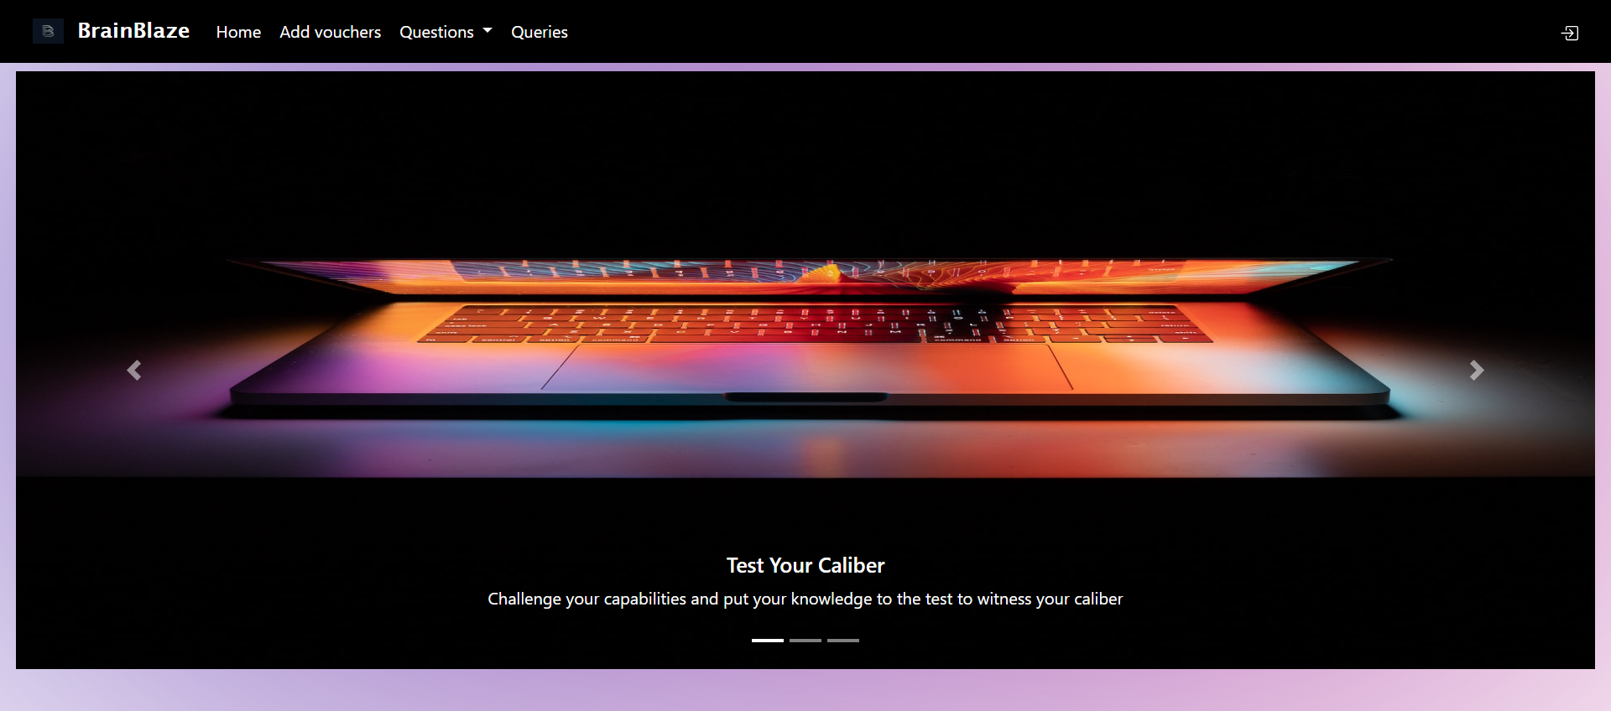
Home Page

Slide 20
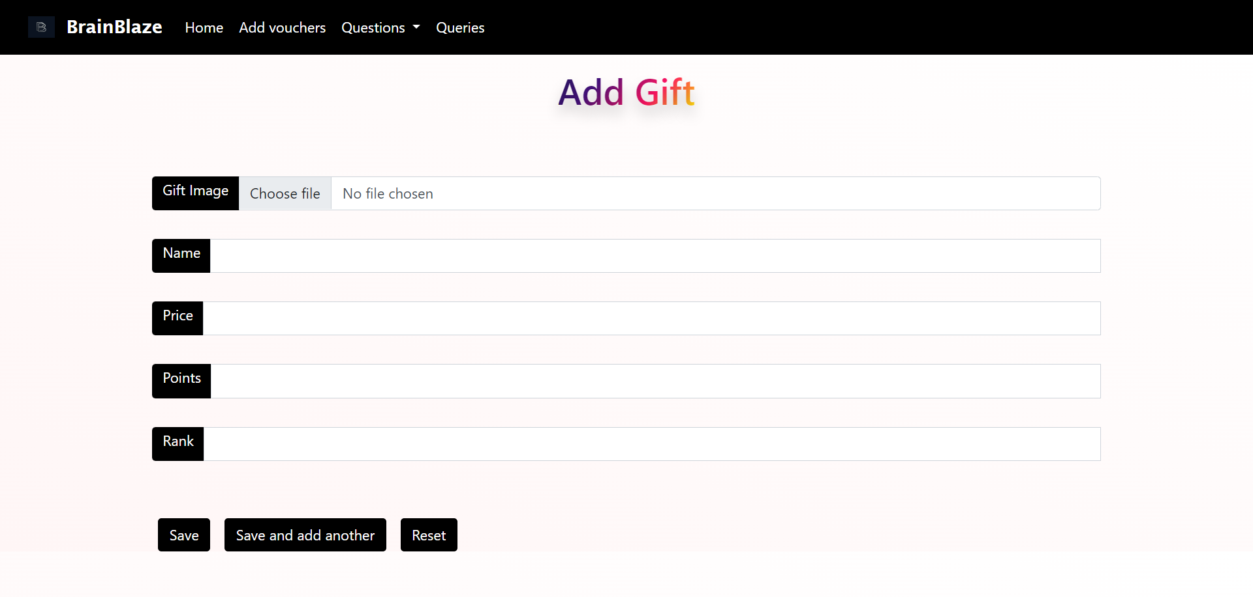
Add gifts

Slide 21
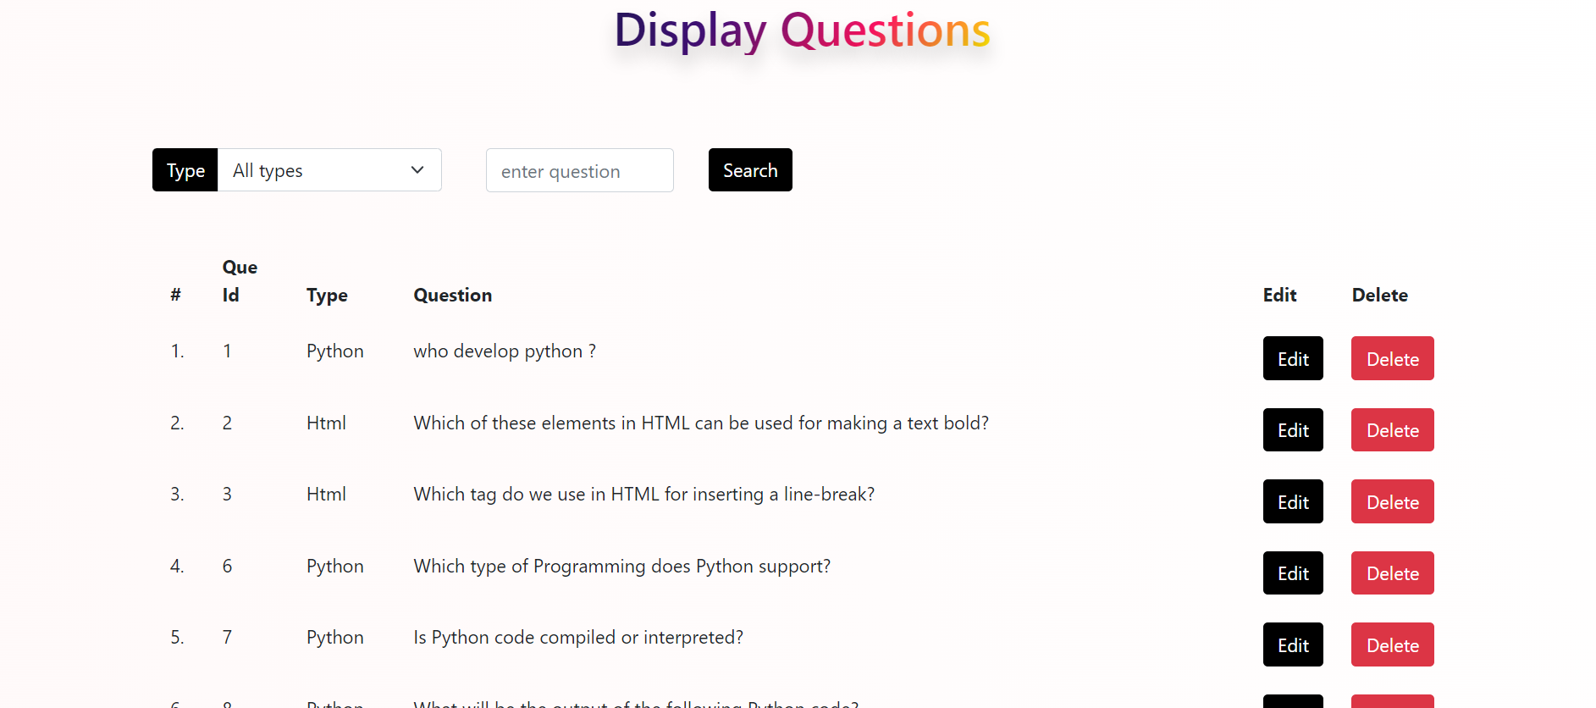
Display Questions

Slide 22
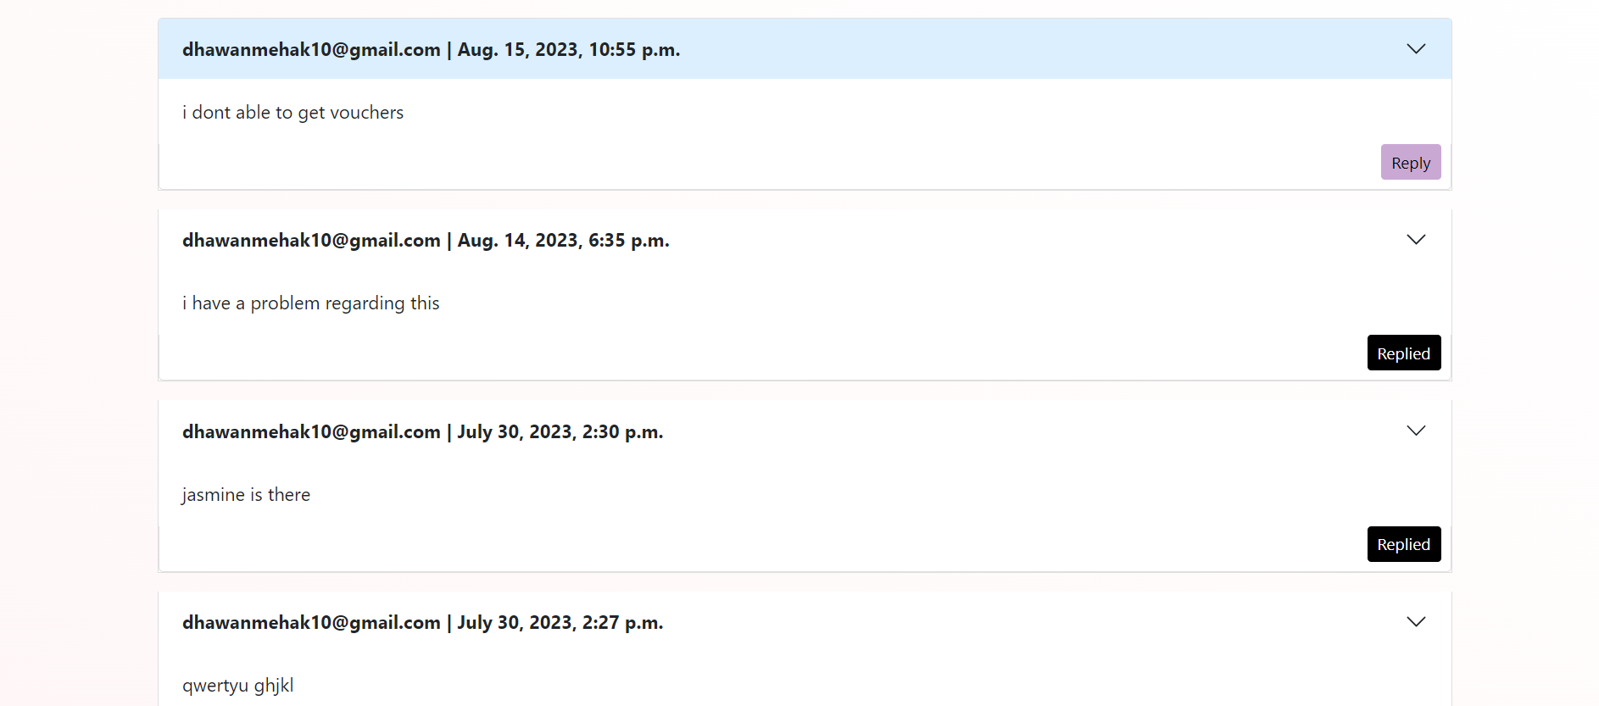
Queries

Slide 23
Thank You

